Slide 1
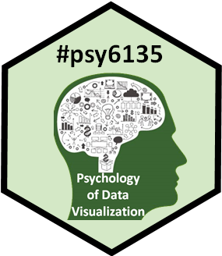
Data Visualization for Social Change
Justine Ledochowski
PSYC 6135
March 28 , 2019

Slide 2

What is social change?
Social change: how and why social, economic and political systems change over time (Shackman, Liu, & Wang, 2002)
Social change involves alteration of the social order of a society. It may include changes in social institutions, social behaviours or social relations. (Wikipedia, accessed Mar 27, 2018)
Social movements of our time:
The Women’s March
Addressing climate change
Movement for a better economy (https://thesocialchangeagency.org/three-movements-to-watch-2019/)

Slide 3
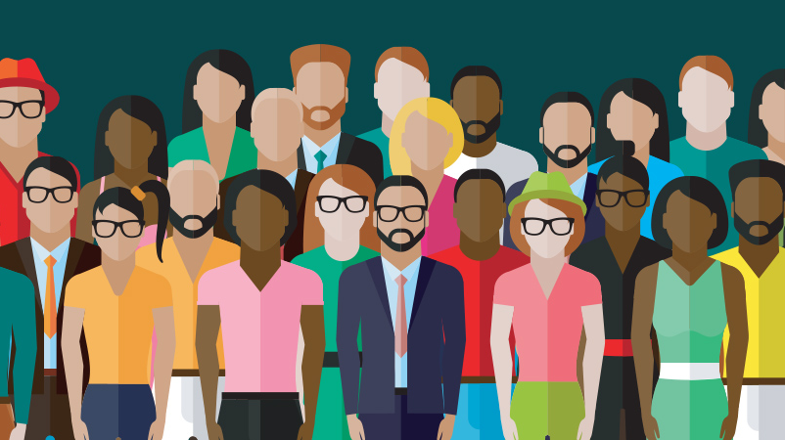
Sociological Imagination
C. Wright Mills (1959)
The awareness of how personal experience is embedded within a wider social context.
Taking yourself out of day-today and view your actions from a third party perspective
Interplay between individual and society
Enable people to become more engaged and involved with public issues.
“Connect personal troubles with public issues”
Lack of sociological imagination can cause apathy
Can data visualization be a tool to facilitate sociological imagination?
Notes:
C. Wright Mills was an American sociologist who coined the term sociological imagination, in his book of the same name
Can data viz be a tool to facilitate sociological imagination?

Slide 4
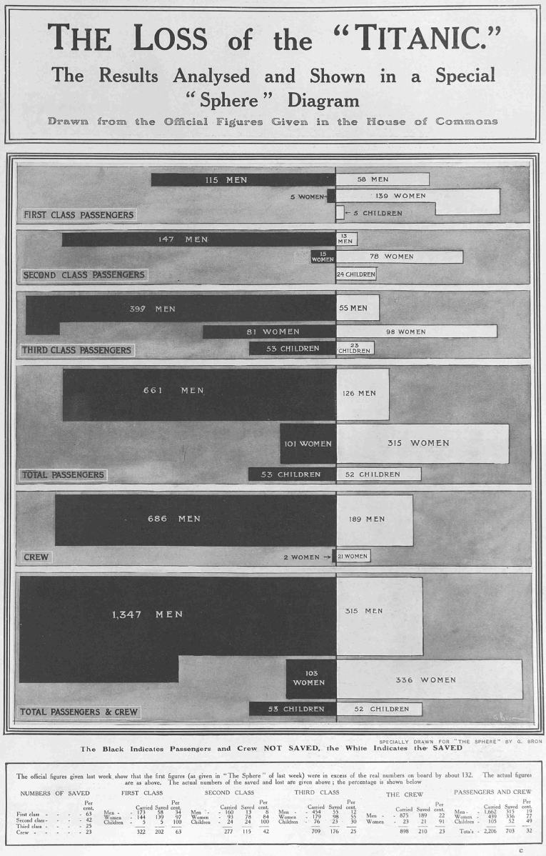
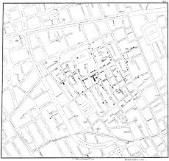
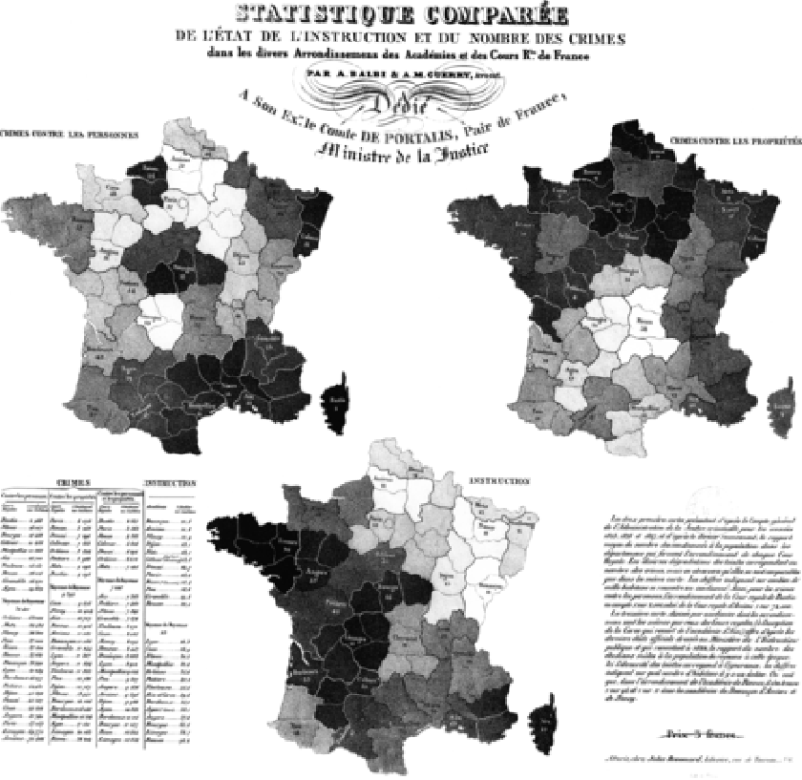
Visualizing social data
John Snow, Cholera Map
G. Bron, The Loss of the Titanic
A-M Guerry, Moral Statistics of France
Notes:
As we have seen in this class visualizing social data is nothing new..
As Dr. Friendly discussed in class (golden age of data vis) Visualizing social data had a “boom” around 1820
Topics: Literacy, education, Crime, suicides, illegitimate births, prostitution, Poverty, debtors, disease
Data vis allows us to put hundreds, even thousands of data points onto a image which is much easier for a person to consume

Slide 5
Guerry’s moral statistics
One of the first to study and link social issues (e.g., crime, literacy, mortality)
Human actions in the social world are governed by social laws
Comparative analysis of social issues
(Friendly, 2007)
Notes:
Not just displaying data but comparing it between regions, looking at interactions between more than one variable
Really the basis of much study of human behaviour.. His legacy remains

Slide 6
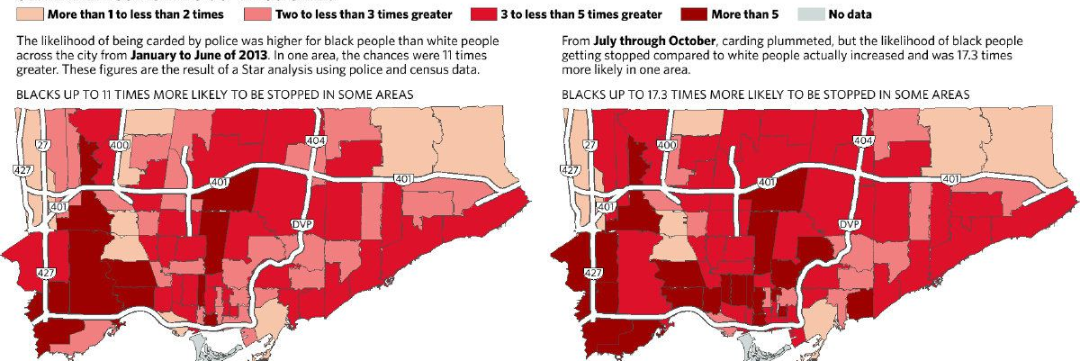
A more recent example…
Jim Rankin
Notes:
We had Jim Rankin in class discussing the interplay between data visualizations and including individuals to tell a story.. Do we need more than the “numbers” to facilitate social change?
Do you think data visualizations can be powerful on their own, or is there another element needed?

Slide 7

Brain Storm
Are there other examples you can think of from class or that you've seen recently?
What do you think makes data visualizations like this compelling?
What kind of social change do you think visualizations could lead to?

Slide 8
Data visualization: What is it good for?
“The visualization functions as a tool to facilitate comprehension and to evoke emotions in the viewers’ minds” (Cairo, 2012)
“Translating dry reports and databases into a format that resonates with human beings is one of the main purposes of data visualization” (Lambert, 2016)
“Successfully illustrating vital data can help advocates maximize the impact of sound science in public debate and policy” (SXSW, 2012)
Notes:
Alberto Cairo (2012). The Functional Art: An introduction to information graphics and visualization
https://schedule.sxsw.com/2012/events/event_IAP10399
https://c4aa.org/2016/01/data-visualization-for-what

Slide 9
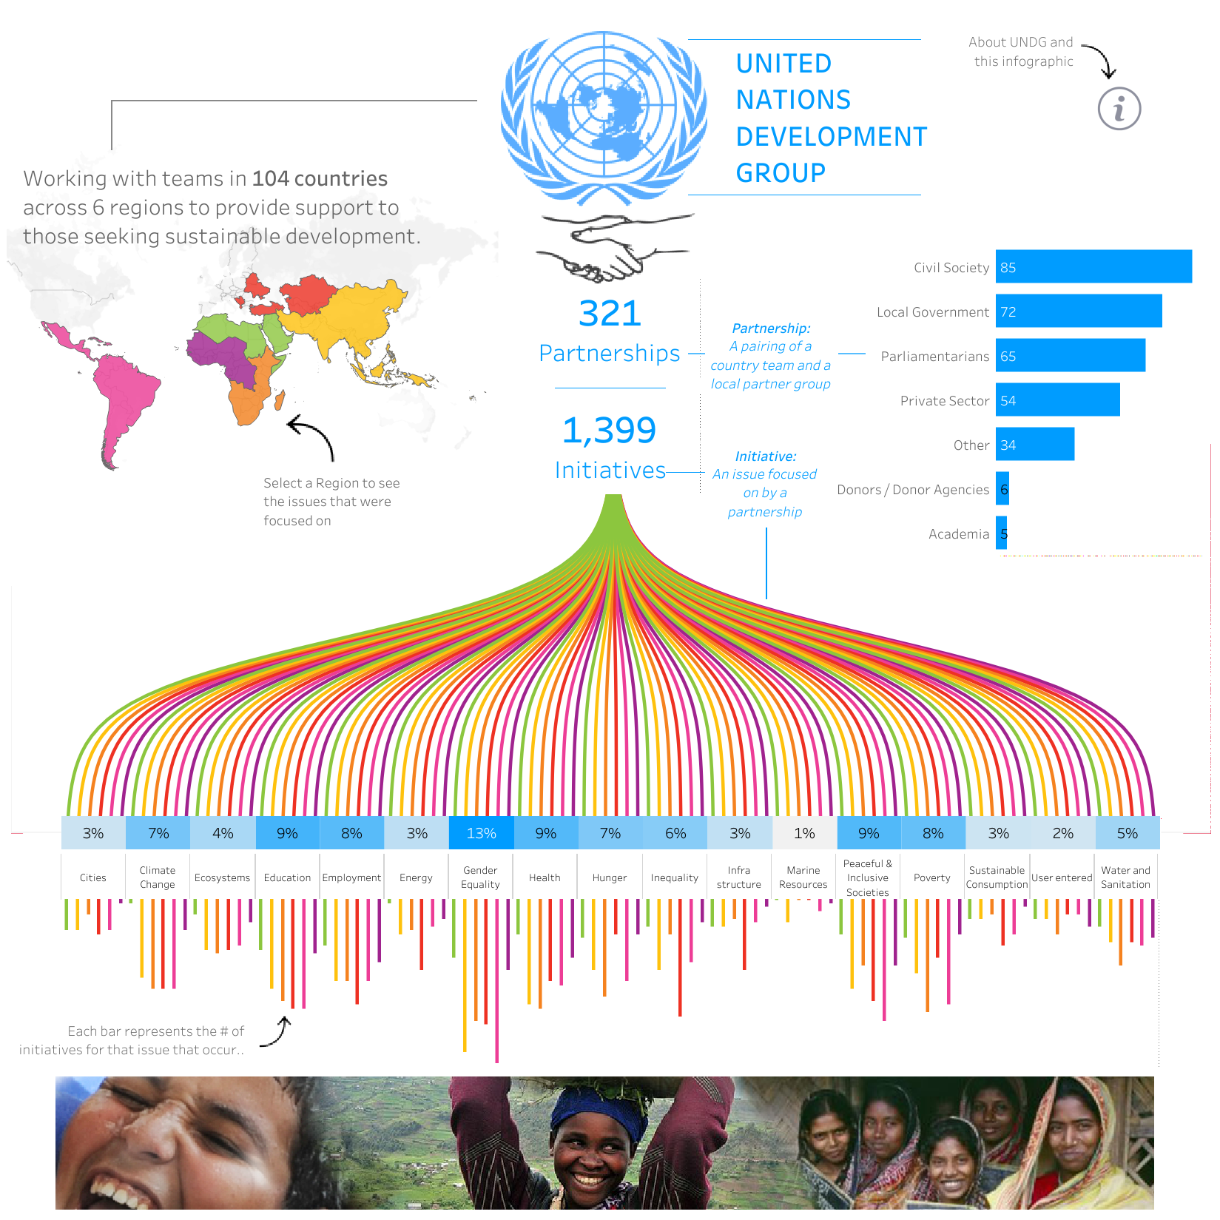
Viz for Social Good
“Harness the power of visualization for social change”
Connects data visualization professionals with non-profits
By: Michael Mixon
https://www.vizforsocialgood.com/
Notes:
“In the past 10 months, Viz for Social Good has grown into a community with more than 500 volunteers globally. We have partnered with several organizations, including the United Nations Children’s Fund to visualize and increase awareness of the child refugee crisis; the United Nations Development Programme to analyze people’s views on poverty, inequality, and climate change to influence global leaders; and Stanford University to identify factors holding women back in science, technology engineering and math.” - https://tdwi.org/articles/2018/11/07/bi-all-visualization-nonprofit.aspx
- Volunteer based

Slide 10
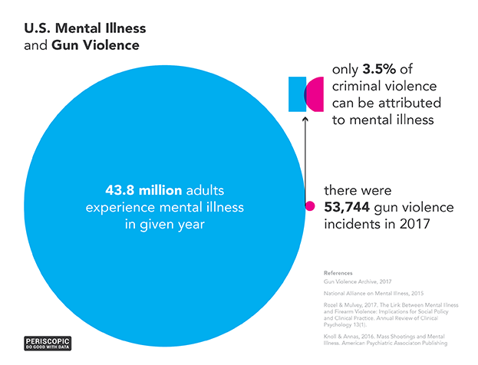
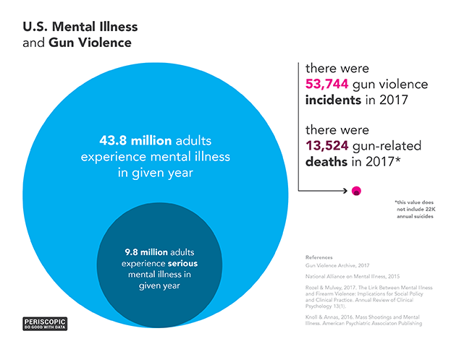
Periscopic Do good with data
“All That Gun Violence is Not a Mental Health Issue”
“A socially conscious data visualization firm”
Notes:
There’s an article with most (all?) visualizations that goes into the issue further than the image, write-up of how they analyzed the data (where it came from, how they approached it etc)
Fee for service, with discounts for non-profits
https://periscopic.com/#!/articles/not-a-mental-health-issue
Same firm that did the 400,000 stolen years gun deaths visualization

Slide 11
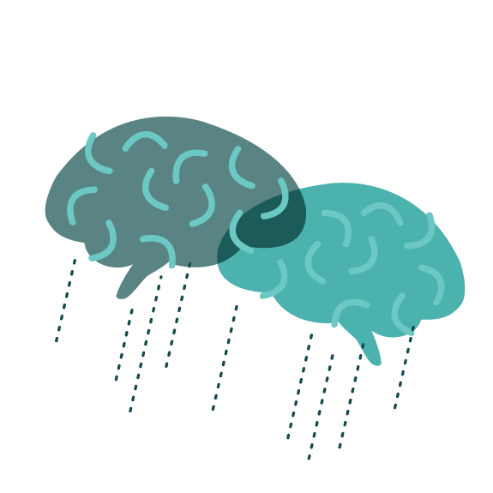
Brain Storm
What are your thoughts on these visualizations?
Would you add anything? Or do anything differently?
As a consumer what are your thoughts when presented with these visualizations?

Slide 12
And what do I do now? Steven Lambert, 2016
“Without moving people to action, experiencing a visualization like this can be tremendously depressing and disempowering because it provides no agency for the audience. When we move people, we must offer a productive outlet for that motivation. Otherwise we confine people in compassion fatigue, frustration, and a resignation to the reality we present: evidence shows the world is colossally f*cked, and there’s nothing you can do to change it. This lesson is learned and remembered. It leads people to be more cynical and less likely to take action on that issue in the future. If our goal is social change, then this can’t be the take-away we communicate to the world.”
Do you agree with this? Or do you think the role of data visualization is to simply present the issue? Or something else?
Notes:
https://c4aa.org/2016/01/data-visualization-for-what
If the goal of the data vis is social change then there’s a next step, argues Lambert
Using the gun deaths visualization as an example. Actually includes many links at the end of his post so practicing what he preaches.
Not just analyzing or presenting data, but acting on it, What can the audience do? How can they act on this information?
“There is nowhere for me to follow through on my outrage or despair. No government official to pressure, no legislation to support, no number to call, or organization to join. I’ve been more than convinced, I’ve been emotionally moved, and in this crucial moment I’m ready to do more. Unfortunately, through this powerful visualization, I’ve been confronted with a reality that I am led to accept, not change” – re the 400,000 stolen years viz

Slide 13

Concluding Thoughts
Data visualization as a tool for social change
Making information more accessible, meaningful
Role in knowledge translation activities, how can we as scientists share our data and effect change?
What role is needed in connecting people to movement?

Slide 14
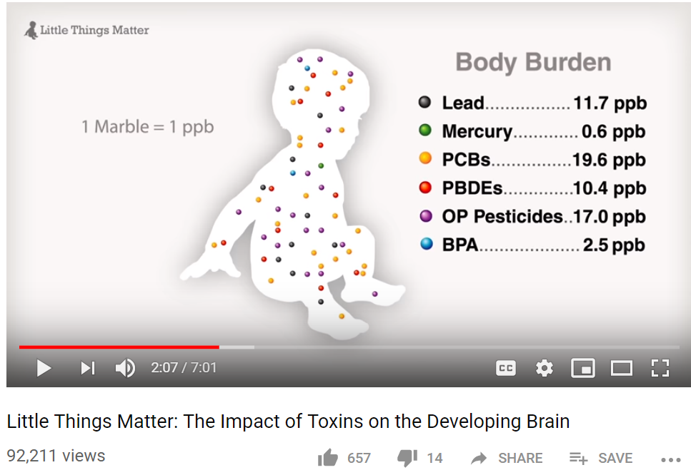
Extra slide: A knowledge translation example
Bruce Lanphear, MD, MPH, professor at Simon Fraser University
Studying childhood exposure to environmental toxins
“Little Things Matter”
https://www.youtube.com/watch?v=E6KoMAbz1Bw&t=289s

